Slide 1
A supervised machine learning approach to arrangement and description OR Data management in the archive
Jennifer Stevenson, PhD
Nuclear Technology
Defense Threat Reduction Agency
Society of American Archivists Research Forum 2018
DISTRIBUTION STATEMENT A:
Approved for public release,
distribution is unlimited
UNCLASSIFIED
Notes:
Good morning. My name is Jennifer Stevenson and I am the head archivist for the Defense Threat Reduction Agency’s Defense Threat Reduction Information Analysis Center. There I work in the Nuclear Technology division which is the modern day Manhattan Project. Today, I am going to discuss some of my current work which involves archives, scientific data management, and machine learning.

Slide 2
Outline
DTRIAC collection
Machine learning 101 and project plan
DTRIAC Machine learning
Project phases
Implications
UNCLASSIFIED
Notes:
Here is an overview of my talk today, so let’s jump right into the DTRIAC collection.

Slide 3
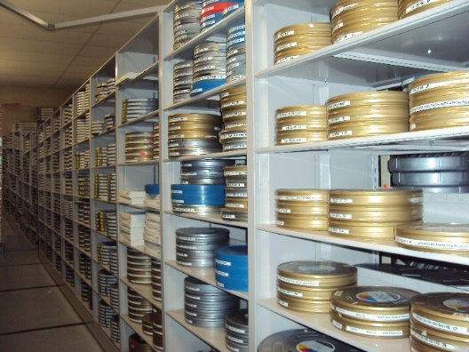
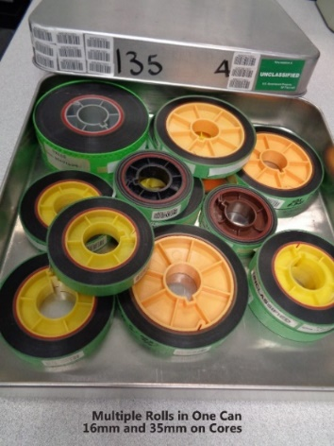
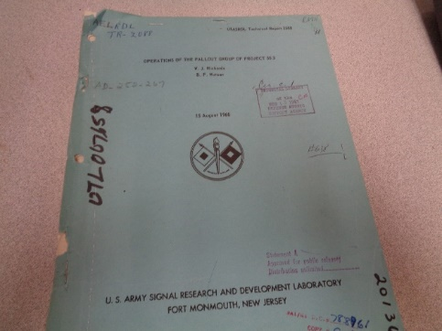
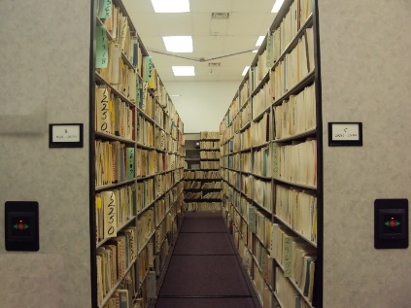
DTRIAC Collection at a Glance
Collection base, 1944 to present
500,000 documents – 20% digitized
Over 150,000 fully digitized and available
Over 400,000 Cataloged records, Indexed by Author, Title, and Abstract
Over 1.5 million inventoried documents
20,000 films – 5% digitized
70mm, 35mm, 16mm, 8mm, VHS
2,000,000 still photos - <1%
Other media types
Over 18,000 test drawings
Several thousand MagTapes
Microfilm, microfiche, computer printouts, etc.
Majority of older records contain nuclear weapons
testing/effects data that cannot be recreated
UNCLASSIFIED
Notes:
The DTRIAC collection consists of both digital and analog material, and an aggressive digitization project will begin this fall that will help us work through our 12,000 backlog. DTRIAC’s collection consists of scientific data with the earliest material beginning at 1944. We have 20,000 plus film, over two million still photographs, and over 500,000 documents. Our arrangement and description needs are based at an item level description.
So how do you get to the science quickly while still creating a space that allows you to evaluate recorded materials and be able to access them?
The answer that we came up with is Machine learning.

Slide 4
Machine learning, Example part 1
Nuclear test
Above ground testing
Below ground testing
UNCLASSIFIED
Notes:
Everyone in this room probably has a basic idea of what is machine learning. In general the basic concept is that computers can ‘learn’ with data with minimal oversight. But what does the search process look like at DTRIAC?
Here is a scenario: A DTRA scientist wants information on a nuclear test. For simplicity sake, let’s narrow this focus into two types of testing: above ground and below ground. Okay. This scientist wants information on underground nuclear tests. Now there are different types of underground tests.

Slide 5
Machine learning, example part 2
Below ground testing
Hunter’s trophy, 1992
Atmospheric information
i.e. weather conditions
Operation names, shots
Location
UNCLASSIFIED
Notes:
But this particular scientist wants information on the last underground test conducted, Hunter’s Trophy (1992).
In this situation what types of information does our machine need to know?
-The difference between underground and above ground testing. Variables that help differentiate this information might be: atmospheric information, i.e. weather conditions, operation and shot names, location, geography.

Slide 6
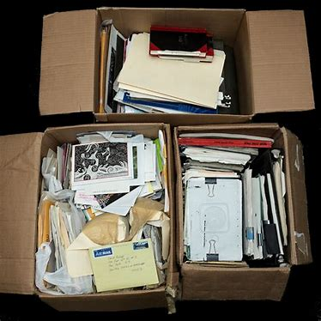
Assessment in real time
Results = 30 items
Hunter’s trophy
Hunters trophy
Huntrs trophy
High altitude shock
High altitude socks
UNCLASSIFIED
UNCLASSIFIED
Notes:
6
The “supervised” portion of the machine learning project comes into play here. The machine runs to find patterns. A sample of the returned results are analyzed. If the agreement rate is high and the analysis reveals that terms are being found. More material is added into the machine. If there is a low agreement rate, for example, a first pass is conducted. The results indicate only 30 retrieved items. This result is low.
Analysis reveals that only one iteration of ‘Hunter’s trophy’ was entered, other iterations of Hunter’s trophy need to be entered in the framework, no Hunters Trophy or Huntrs Trophy. Another example, high altitude shock, misspellings like ‘high altitude socks’. Here are some images of what our material looks like behind the scenes.

Slide 7
DTRIAC Machine learning
Purpose:
Test the effectiveness of machine learning technologies
Learn from human assigned metadata
Automatically assign metadata to digitized items
Expedite the process of cataloguing 12,000 cu feet
Process:
Selection of metadata elements and review
Creation of training set
Development of machine learning algorithm model
Application of algorithm to 100 un-identified items and manually review the 100 items
Find agreement rate
Review effectiveness
UNCLASSIFIED
Notes:
Here is an overall summary of the purpose and process from testing, metadata generation, to creating a training set, and reviewing the effectiveness.

Slide 8
End state: Machine learning as a tool
Time saving scalability tool
Not a replacement for manpower but is a force multiplier
Metadata tag 100 items instead of 5 million
Will create a stronger search feature
Ability to create ad hoc research from reliable and sound data
Makes inaccessible information accessible
UNCLASSIFIED
Notes:
I would like to point out that this is an iterative process and will continue to be. This is a time saving tool and not a replacement for manpower but a force multiplier. The long term implementation of machine learning at DTRIAC will be that once we begin getting results, i.e. terms associated with these documents. These terms and documents will be taken from our Machine Learning sandbox and placed into our STARS search system.
So when I say this process is iterative what I mean is the terms developed a 1.5 years into the program will be better than the first terms developed. As a result, the search and retrieval process will yield higher successes. In addition, in the future our STARS search system will add in a ‘tag’ feature for users. The ‘tags’ identified by SME’s will be added to DTRIAC’s machine learning sandbox.

Slide 9
Implications
Archival process and machine learning
MPLP
Machine learning suggests . . .
Archivists richly describe small unprocessed portions of archival holdings
Feed into supervised machine learning, allowing the machines to overcome the scale of the collections
UNCLASSIFIED
UNCLASSIFIED
Notes:
This project is experimental, we are only in the first phase. DTRIAC’s main issue is data management rather than archival so like William Underwood’s work, my focus is on exposing scientific data rather than exposing document types.
The biggest implication if this research is potentially exposing a way to grabble with HUGE backlogs. This process differs from MPLP which offers a framework for providing a skimmed view of collections; the DTRIAC machine learning framework starts with a small richly described portion of the collection, and through the use of machine learning harnesses the machines to work with the scale of the collection.
Thank you.

Slide 10
Backup Slides

Slide 11
Background
Key Department of Defense source of information and analysis on nuclear and conventional weapons-related topics
DTRIAC collection purpose
Perform analyses on DTRA-internal and community-wide nuclear/conventional weapons phenomena
Effects and technology matters
Related nuclear/conventional technology transfer applications
DTRIAC collection
Atmospheric testing era from 1946 to 1962
Scientific data relating to fireball physics, shock-wave physics, and early-time and late-time cloud behavior
UNCLASSIFIED
11
Notes:
Military IACs
DTRIAC--Defense Threat Reduction
APMIAC--Airfields, Pavements, and Mobility CEIAC--Coastal Engineering Defense CRSTIAC--Cold Regions Science and Technology CTIAC--Concrete Technology EIAC--Environmental HEIAC--Hydraulic Engineering SAVIAC--Shock & Vibration SMIAC--Soil Mechanics
DTIC IACs
AMMTIAC--Advanced Materials, Manufacturing & Testing CBRNIAC--Chemical, Biological, Radiological & Nuclear Defense CPIAC--Chemical Propulsion DACS--Data & Analysis Center for Software IATAC--Information Assurance Technology MSIAC--Modeling and Simulation RIAC--Reliability SENSIAC--Military Sensing SURVIAC--Survivability/Vulnerability WSTIAC--Weapons Systems Technology

Slide 12
Project phases
Phase I
Training with a small subset of the collection
Gradually phase in material in sets of 10,000
Training by metadata
Phase II
Semantic meaning
Phase III
Identification of tables, charts
UNCLASSIFIED

Slide 13
Work timeline
Average 20 pages per document
1 minute per
10 million minutes = 19.0258752 years
UNCLASSIFIED

Slide 14
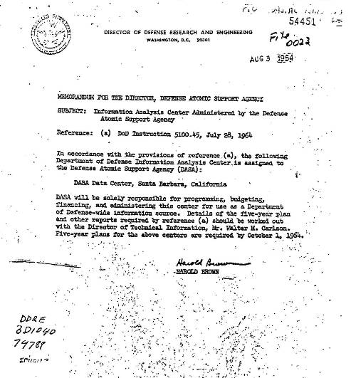
Current DTRA Information Analysis and Preservation Authority
“…the following Department of Defense Information Analysis Center is assigned to the Defense Atomic Support Agency (DASA): DASA Data Center…DASA will be solely responsible for programming, budgeting, financing and administering this center for use as a Department of Defense-wide information source.”
Aug 3, 1964
UNCLASSIFIED

Slide 15
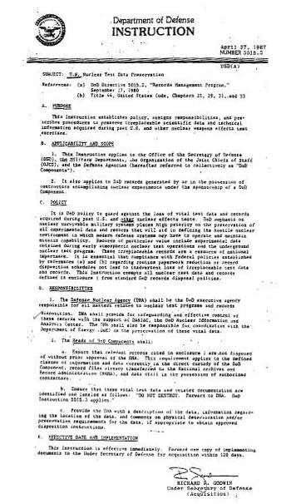
Current DTRA Information Analysis and Preservation Authority
DoD Inst 5015.3
April 27, 1987
Subj: US Nuclear Test Data Preservation
“The Defense Nuclear Agency (DNA) shall be the DoD executive agency responsible for all matters related to nuclear test programs and records disposition. DNA will provide for safeguarding and effective control of these records with the support of DASIAC, the DoD Nuclear Information and Analysis Center.”
UNCLASSIFIED

